Slide 1




Level 0
INTRO TO PS
session 1
prepared by : Kareem Elgoker
ICPC
MANSOURA

Slide 2

Who AM I?
TECHNIAL HEAD OF ICPC MANSOURA CCSED LEVEL 200 YEAR AND HALF OF EXP IN PS ECPC PLAY PING PONG :)

Slide 3



RULES

Slide 4
Week

Slide 5


WHAT IS PS?

Slide 6


lv zero
1
What is ps?
Agenda
2
ECPC Competition?
3
C++ Basic Structure
4
Conditions
5
Loops

Slide 7

Define the problem
Evaluate and select
State the problem specifically
Consult each faction involved for information
Skilled problem solvers use a series of considerations when selecting the best alternative.
Problem
SOLVING
Generate solutions
Implement
Think of trivial solution
Brainstorm on others' ideas
Seek alternatives that may solve the problem
Write your idea with the best approach

Slide 8




CORRECT IDEAS
WRONG IDEAS
compare
compare
compare

Slide 9
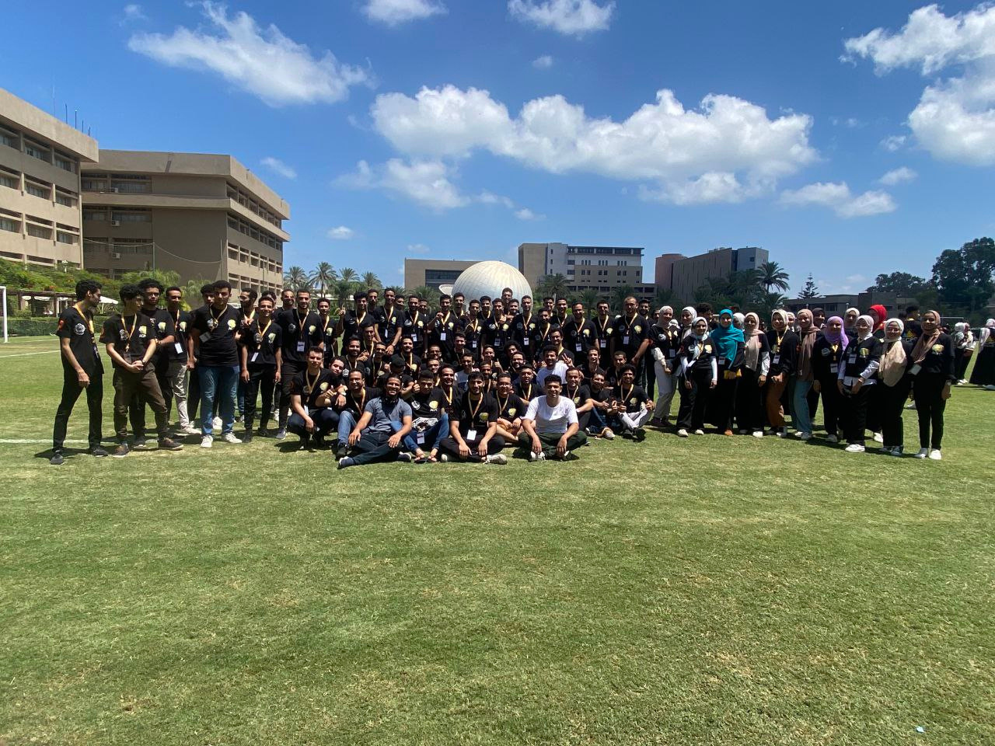
ECPC
?

Slide 10



Python - Slow
C - No DS
C# - Structured
Java - Structured
C++
Why
C++

Slide 11
coding time
C++ Structure

Slide 12




Data Types
1
IO Operations
2
Arithmetic OP
3
Logical OP
4

Slide 13


Data Types
1
2
3
4
5
BOOL
CHAR
INT
FLOAT
STRING
1 Byte
1 Byte
short int (2)
int == long (4)
long long (8)
float (4)
double (8)
long double (16)
0 - oo
true - false
0 - 1
-128 - 127
0 - 255
‘\n’
Dangerous

Slide 14
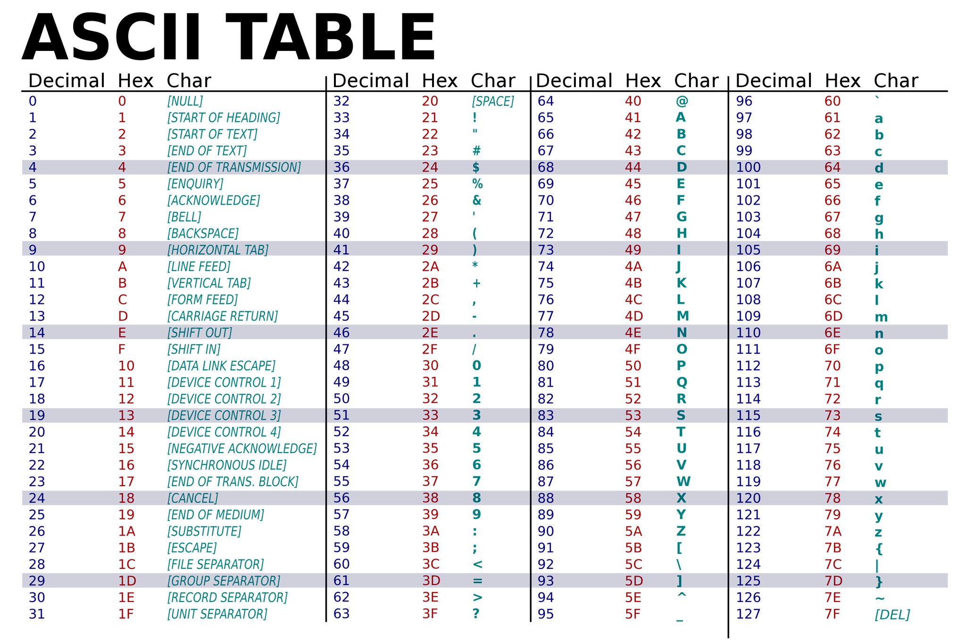

Slide 15


INPUT & OUTPUT
IN C++
HELLO ICPC
HELLO ICPC
ios_base::sync_with_stdio(false);
INPUT :
cin >> var;
cin >> var1 >> var2;
OUTPUT :
cin.tie(NULL);
cout.tie(NULL);
cout << var;
endl???
cout << fixed << setprecision(x) << var;
Don’t Forget (#include <iomanip>)

Slide 16
coding time

Slide 17
Arithmetic
Assignment
01.
OPERATORS
02.
LOGICAL
Operators are used to perform operations on variables and values.
03.
Comparison

Slide 18






Arithmetic
Assignment
LOGICAL
Comparison
a + b
a - b
a * b
a / b
a % b
>
<
<=
>=
a = b
a += b
a -= b
a *= b
a /= b
a %= b
&&
||
!
ceil
floor
round
==
!=

Slide 19

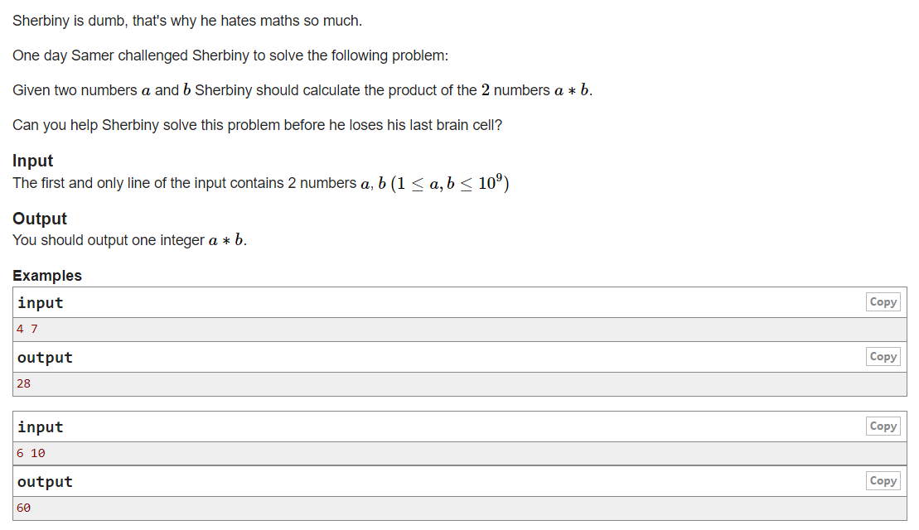
Statement
PROBLEM
LINK

Slide 20
solution

Slide 21
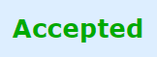
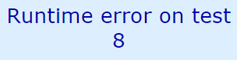
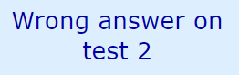

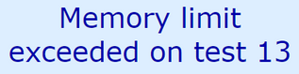
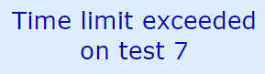
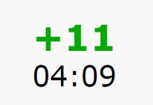
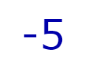
CODEFORCES

Slide 22
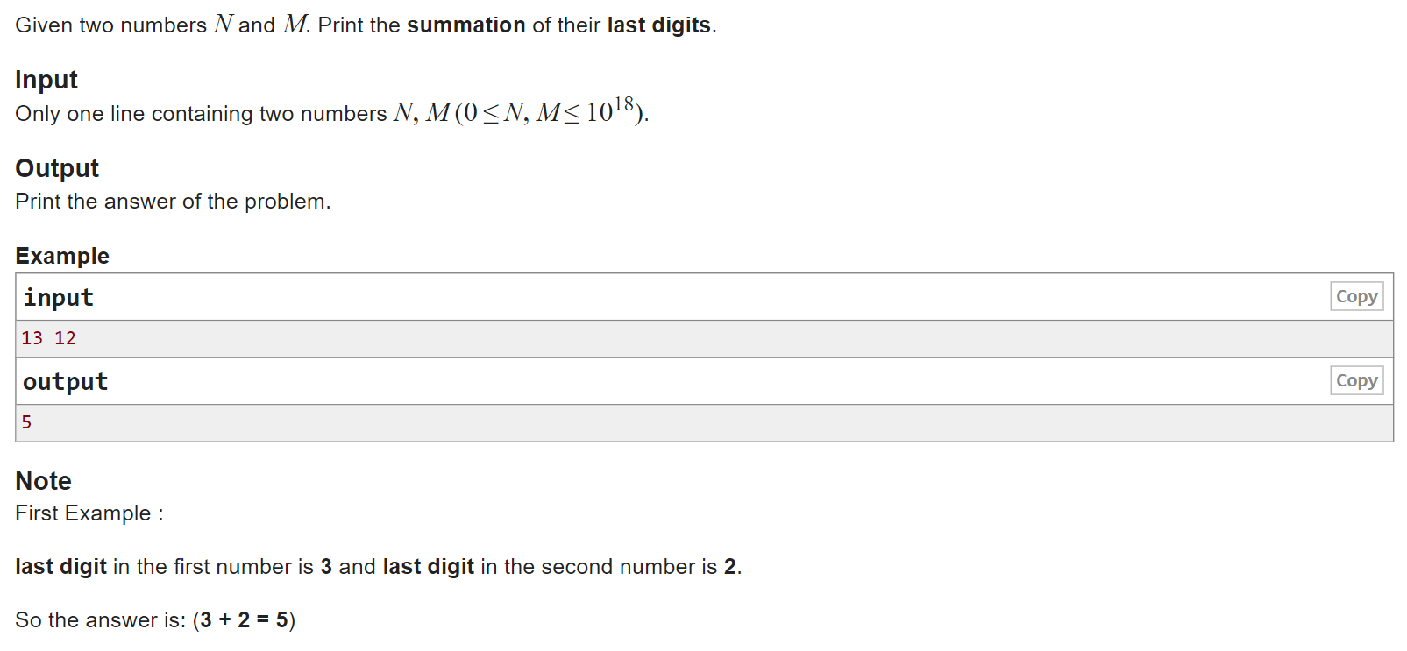
Statement

Slide 23
If Condition
1
If - Else
2
If - Else if - Else
3
Switch *
4

Slide 24
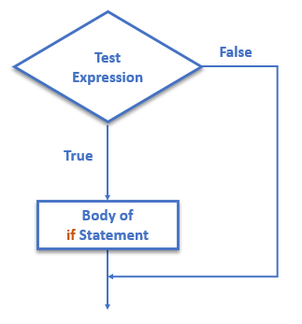
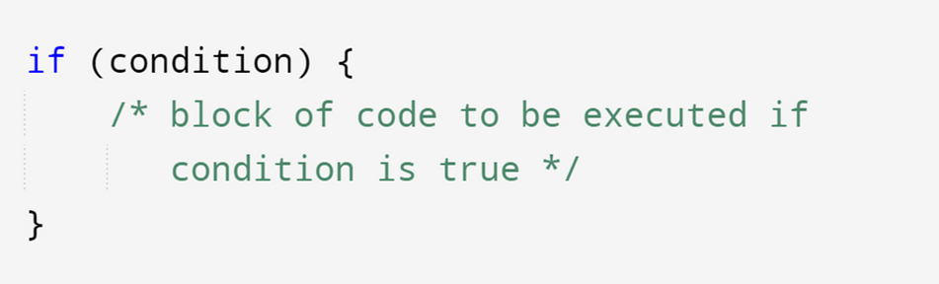
If Condition
The if keyword is used to execute block of code, if the condition is true.
Syntax :

Slide 25
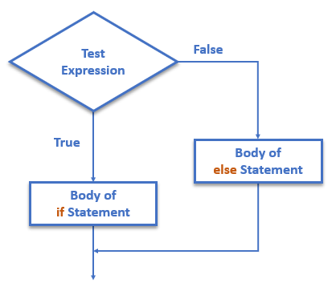
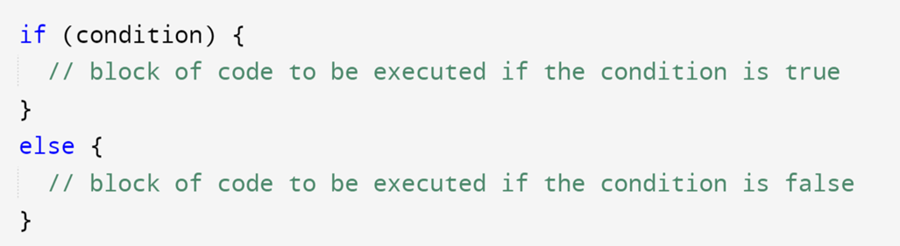
If - Else
The else keyword is used to execute block of code, if the condition is false.
Syntax :

Slide 26
Parity

Slide 27
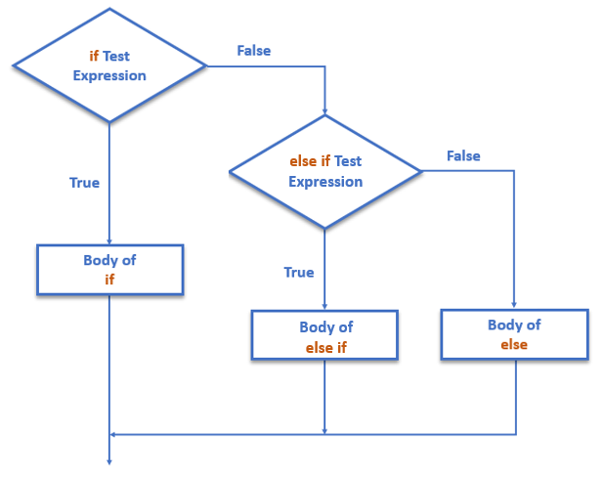
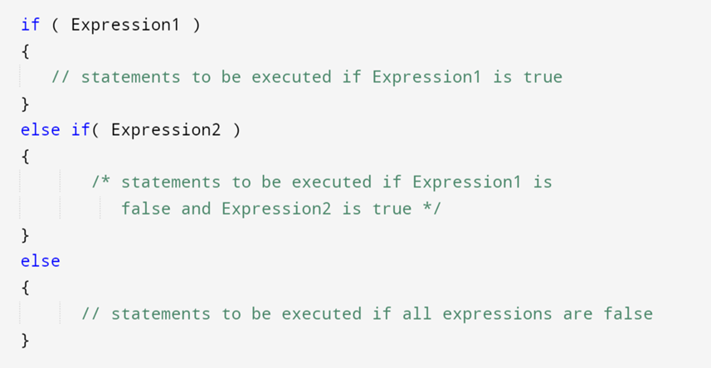
If - Else if
The else if keyword is used to specify a new condition, if the previous condition is false.
Syntax :

Slide 28
GRAding

Slide 29



TERNARY OPERATOR
There is also a short-hand if..else, which is known as the ternary operator because it consists of three operands. It can be used to replace multiple lines of code with a single line.
NOTE : expression data type must be identical

Slide 30
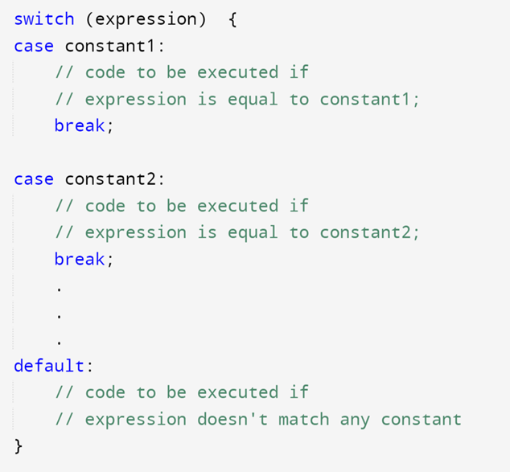
Switch Case
The switch keyword is used to select one of many code of blocks to be executed.
Syntax :

Slide 31




What is the
day?

Slide 32
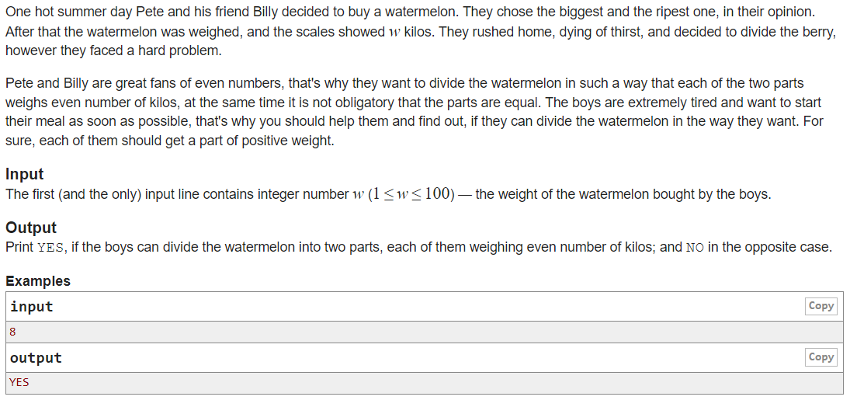
Statement
PROBLEM
LINK

Slide 33
discussion

Slide 34
solution

Slide 35

Break time

Slide 36
01.
For loop
LOOPS
02.
While
In computer programming, loops are used to repeat a block of code.
03.
Do While *

Slide 37
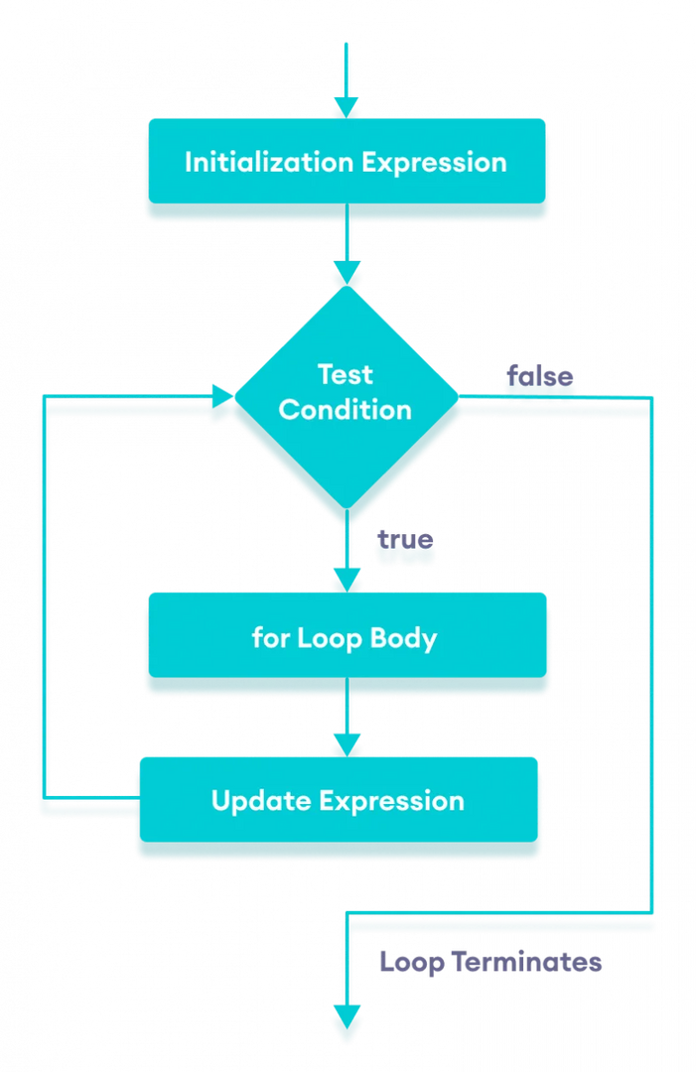
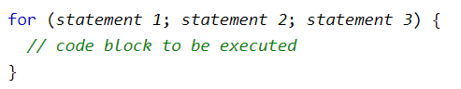
For loop
Syntax :

Slide 38
Print 1 - N

Slide 39
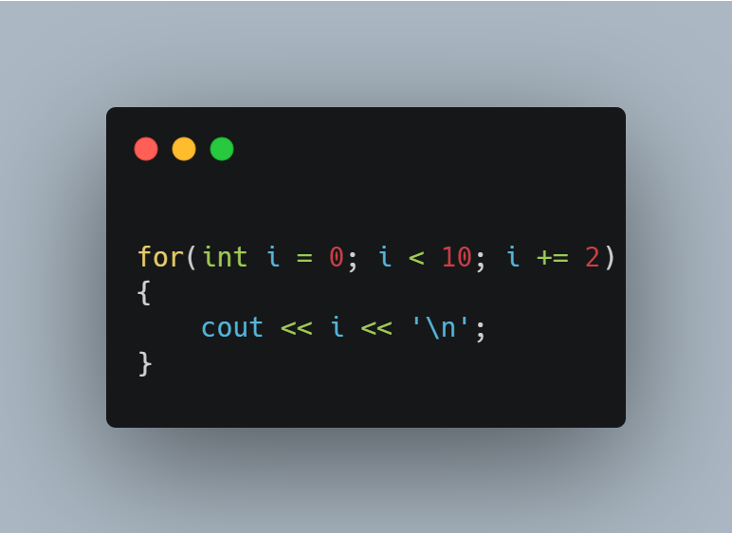
OUTPUT
?

Slide 40

OUTPUT
?

Slide 41

OUTPUT
?

Slide 42
SECOND
THE SECOND IN C++ CAN HANDLE UP TO 10^8 OPERATION. SO CHECK YOUR LOOP FOR EVERY PROBLEM

Slide 43
SUM 1 - N

Slide 44
discussion

Slide 45
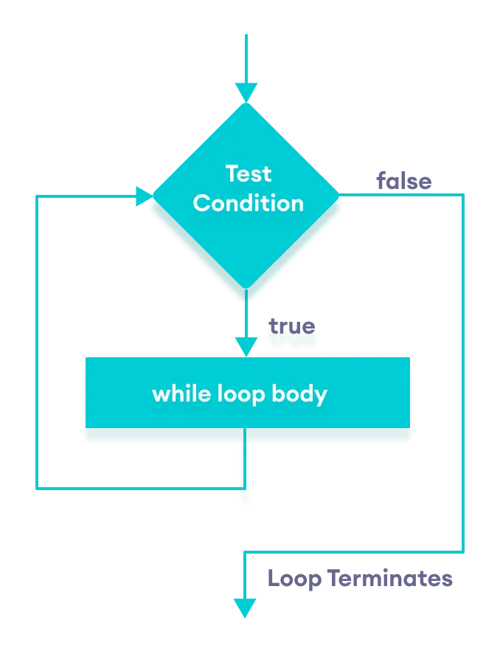
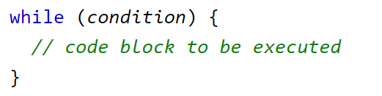
While loop
Syntax : Be Careful of infinite

Slide 46
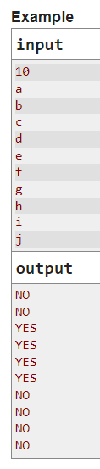
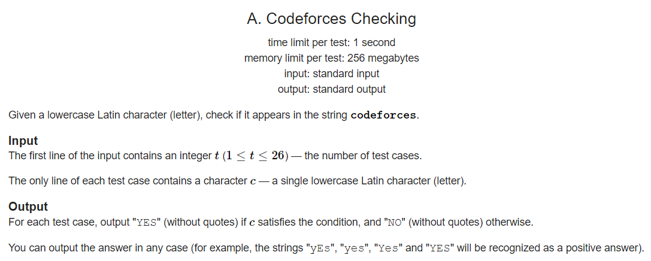
Statement
PROBLEM
LINK

Slide 47
coding time

Slide 48
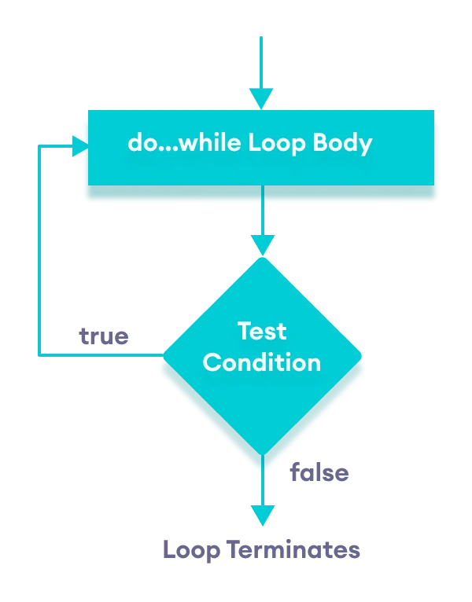
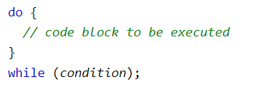
DO WHILE
DO CODE + Normal While
Syntax : Be Careful of infinite

Slide 49
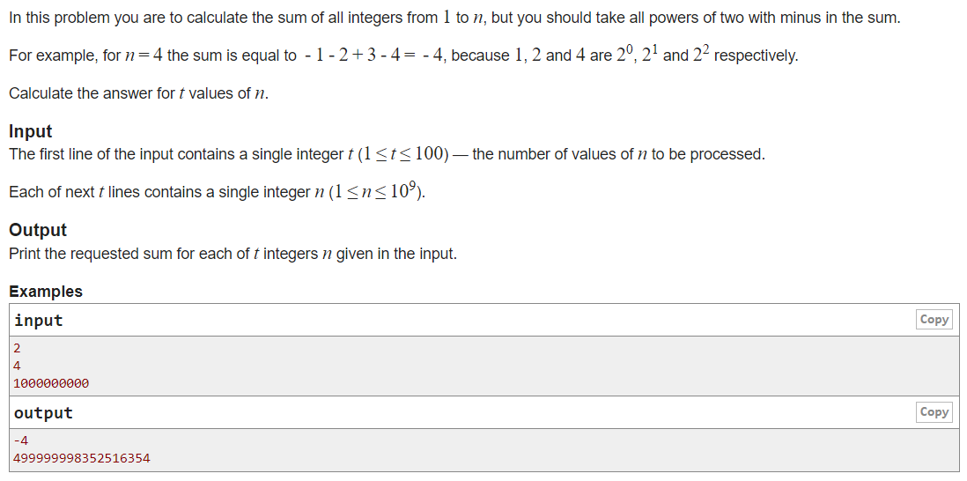
Statement
PROBLEM
LINK

Slide 50
coding time

Slide 51


conclusion
What we do?
c++ structure
data types
operators
conditions
loops

Slide 52

thank you

